Slide 1
Experimental Results Achieved with BITMAPS
I. DE MICHELIS, Associate Professor
University Of L’Aquila
Final Conference, 17/09/2020, Avezzano (Italy)

Slide 2
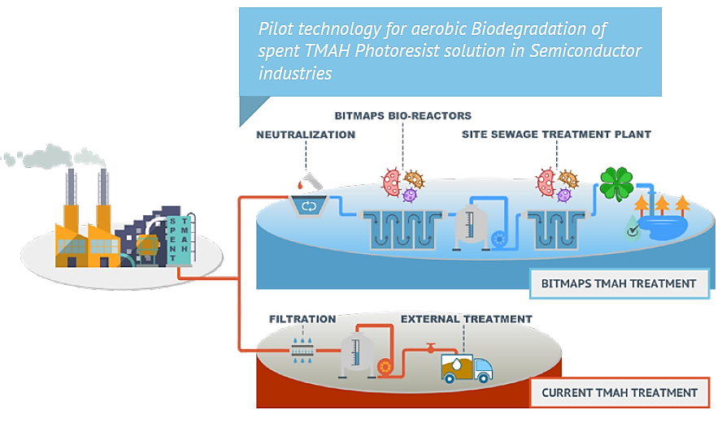
LIFEBITMAPS PROJECT

Slide 3
LIFEBITMAPS PROJECT
ONE OF THE KEY OBJECTIVE:
Demonstrate, at industrial scale, the feasibility/sustainability for TMAH treatment through an aerobic biodegradation of such toxic substance carried out by adapted microorganisms selected during the R&D phase.

Slide 4
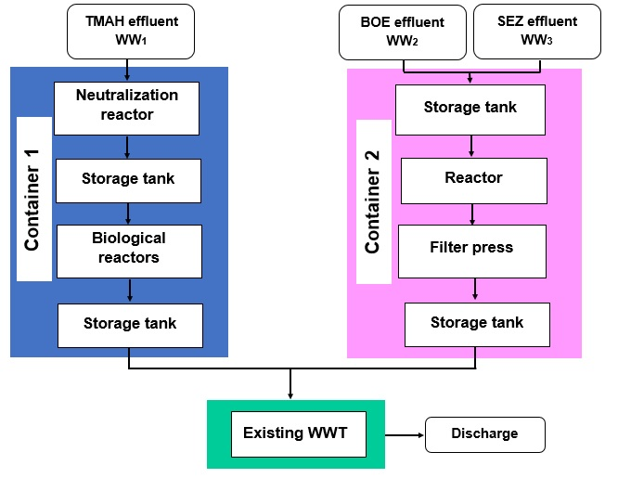
LIFEBITMAPS PROJECT

Slide 5
LIFEBITMAPS PROJECT
Average composition of WW1
pH | 12
TMAH | 2161 mg/L
N-NH4 | 7.4 mg/L
N-NO3 | < 0.15 mg/L
Dimethylamine (DMA) | < 0.05 mg/L
Three run of experiments
Batch and Continuos mode
Different flowrate

Slide 6
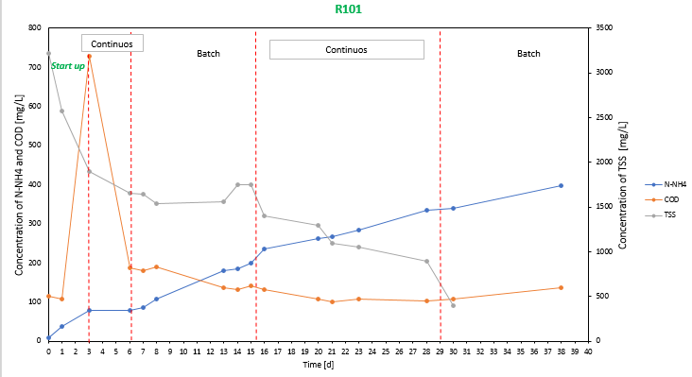
LIFEBITMAPS PROJECT
First Run
Trend of some parameters in the reactor R101

Slide 7
LIFEBITMAPS PROJECT
First Run

Slide 8
LIFEBITMAPS PROJECT
TMAH and degradation products disappear. TMAH was completely degraded in the first biological reactor.
NO3 conc. increases: nitrification process, by which ammonia is oxidated to nitrate, happens

Slide 9
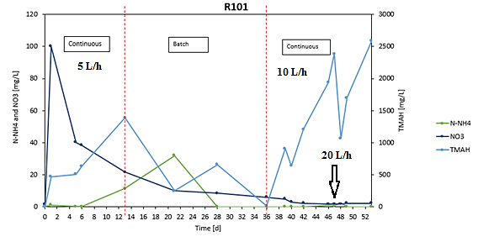
LIFEBITMAPS PROJECT
Second Run
Trend of some parameters in the reactor R101
Wash-Out

Slide 10
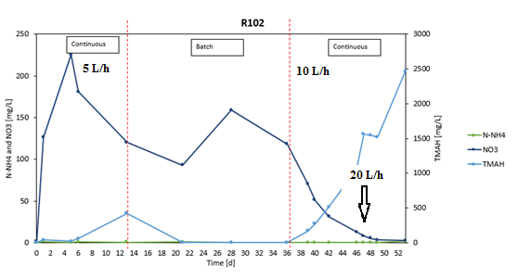
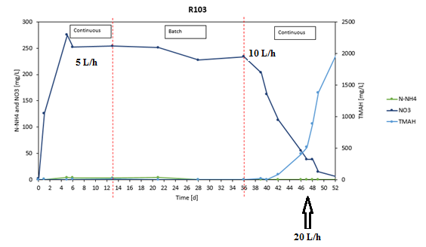
LIFEBITMAPS PROJECT
Residence time is insufficient to allow microorganisms duplication
Optimal flowrate value: 5L/h

Slide 11
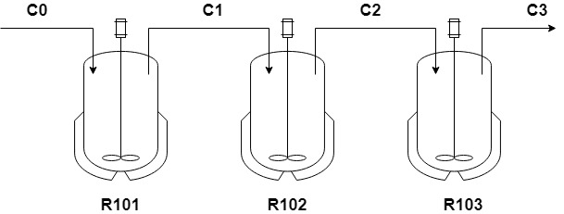
LIFEBITMAPS PROJECT
Material balance for each reactor:
TMAH Degradation yields (%) for each reactor (5L/h)
Time [h] | R101 | R102 | R013
48 | 7.53% | 45.10% | 55.38%
168 | 61.46% | 96.47% | 99.97%
192 | 55.48% | 90.82% | 99.02%

Slide 12
LIFEBITMAPS PROJECT
Third Run
Trend of TMAH at 5L/h
failure

Slide 13
LIFEBITMAPS PROJECT
Third Run
failure
It is possible to justified biological system failure by microorganism suffering due to carbon deficiency. During the tests no additional source of carbon was added. It is possible to hypothesize that in the initial phase the system is not affected by the lack of carbon

Slide 14
LIFEBITMAPS PROJECT
Second Run vs Third Run
despite the thermostat control system, the average temperature in biological reactors, during the 2018 tests, was below 20 ° C, while in tests conducted in June 2019 the temperature was on average around 25 ° C (optimal temperature according to laboratory data)

Slide 15
LIFEBITMAPS PROJECT
 | TMAH Removal Yield
Time (h) | R101 | R102 | R103
96 | 99,9% | 99,9% | 76,2%
192 | 78,5% | 99,9% | 94,6%
288 | 100,0% | 100,0% | 99,9%
360 | 100,0% | 100,0% | 99,9%
432 | 95,1% | 100,0% | 100,0%
504 | 89,4% | 99,6% | 99,4%
600 | 99,7% | 99,7% | 99,5%
TMAH removal yield with respect to theoretical value

Slide 16
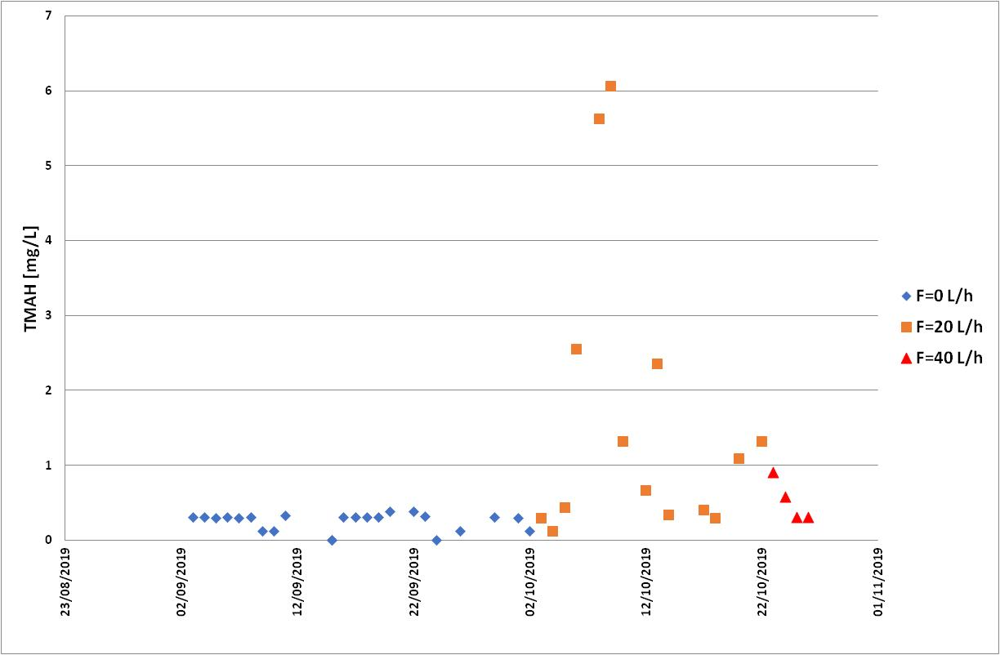
LIFEBITMAPS PROJECT
Lfoundry depurator tests

Slide 17
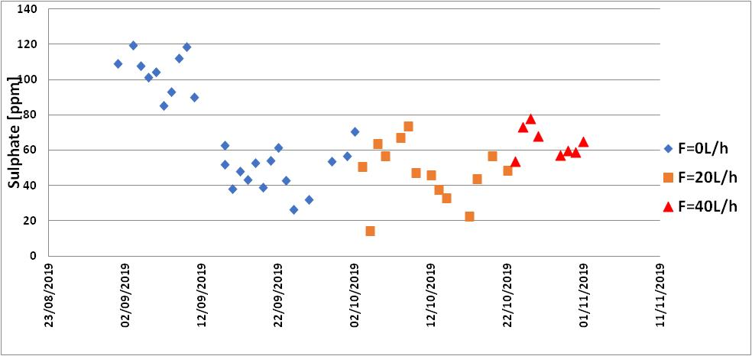
LIFEBITMAPS PROJECT
Lfoundry depurator tests

Slide 18
LIFEBITMAPS PROJECT
SEZ treatment
Reagent consumption for SEZ treatment
Date | pH |  | Volume of wastewater, L | Reagent consumption, kg
 | initial | final |  | Al₂(SO₄)₃ | Ca(OH)₂, 16%
24/09/18 | 1.5 | 4.5 | 102.14 | 3.00 | 200.0
8/11/18 | 1.5 | 4.9 | 99.10 | 3.04 | 95.4
15/11/18 | 1.5 | 5.2 | 101.3 | 3.00 | 144.3
Wastewater SEZ parameters before and after treatment
Date | Waste water |  | Precipitate, %
 | F, mg/L |  | Water content | Ca | Al | Na | P | S
 | initial | final
24/09/18 | 20600 | 7.8 | 65.5 | 62.1 | 3.5 | 6.8 | 19.2 | 7.7
8/11/18 | 16400 | 9.6 | 56.4 | 58.5 | 4.6 | 6.8 | 19.4 | 10.1
15/11/18 | 17500 | 5.1 | 55.7 | 62.4 | 2.1 | 7.7 | 23.4 | 3.8

Slide 19
LIFEBITMAPS PROJECT
BOE treatment
Reagent consumption for BOE treatment
Date | pH |  | Volume of wastewater, L | Reagent consumption, kg
 | initial | final |  | Al₂(SO₄)₃ | Ca(OH)₂, 16%
04/10.18 | 4.8 | 11.8 | 100 | 4.0 | 182.8
15/10/18 | 5.3 | 9.2 | 105 | 4.0 | 120
31/10/18 | 5.4 | 9.9 | 94.3 | 4.0 | 89
Wastewater BOE parameters before and after treatment
Date | Wastewater |  |  |  |  | Precipitate, %
 | F, mg/L |  | PO₄, mg/L |  | NO₃, mg/L | Water content | Ca | Al | P | Na
 | initial | final | initial | final |  | Water content | Ca | Al | P | Na
04/10.18 | 97 | 5.3 | 245 | 0 | 29000 | 48.1 | 91.7 | 1.9 | 4.8 | 1.1
15/10/18 | 418 | 4.6 | 333 | 0 | 762000 | 51.2 | 90.4 | 2.5 | 5.2 | 1.2
31/10/18 | 25700 | 9.9 | 380 | 0 | 16500 | 53.4 | 90.9 | 2.2 | 5.0 | 1.4

Slide 20
LIFEBITMAPS PROJECT
Conclusions:
data showed that using a loading of TMAH solution of 5 L/h and after 192 h of reaction it has been possible to reach 55.48%, 90.82% and 99.02% of removal in R101, R102 and R103, respectively.
DMA appears after 48 h and it is degraded by bacteria in 192 h that product ammonium.
nitrification process was more relevant in the last bioreactor.
the 5 ° C increase in temperature improves the kinetics of the system

Slide 21
LIFEBITMAPS PROJECT
Conclusions:
about system biology, changes in pH and nutrient inlet causes the selection of different species into the reactor;
changes in operational parameters, such as variation to inlet/outlet amount per hour, should be made with extreme caution
an automated pH controller should be considered, to maintain acidity to optimal levels, avoiding dangerous shifts in microbial community.

Slide 22
LIFEBITMAPS PROJECT
Conclusions:
SEZ and BOE: both effluents can be treated by the addition of lime and aluminium sulphate as precipitation coadjuvant;
fluoride removal yield is around 99% for both effluents;
lime consumption depends from initial composition of the effluent and from the age of the lime.

Slide 23
Thank You very much for your attention !
This Project receives funding form the European Union Life Programme Under Grant Agreement N. LIFE 15 ENV/IT 000332.

